Slide 1
Exploring and Comparing Database Modeling using Open Target Genetics Data from SQL to noSQL
Wenliang Zhang
CS779 Advanced Database Management
Final Project 2021 Fall
2021.12.09

Slide 2
Agenda
Introduction to Open Target Genetics Datasets
HDFS with Hive and Impala – my current implementation
Goals and Challenges
Advantages and Disadvantages
Explore and Compare Other Database Solutions
PostgreSQL
TileDB
MongoDB
MongoDB + Spark
Web Application Demo

Slide 3
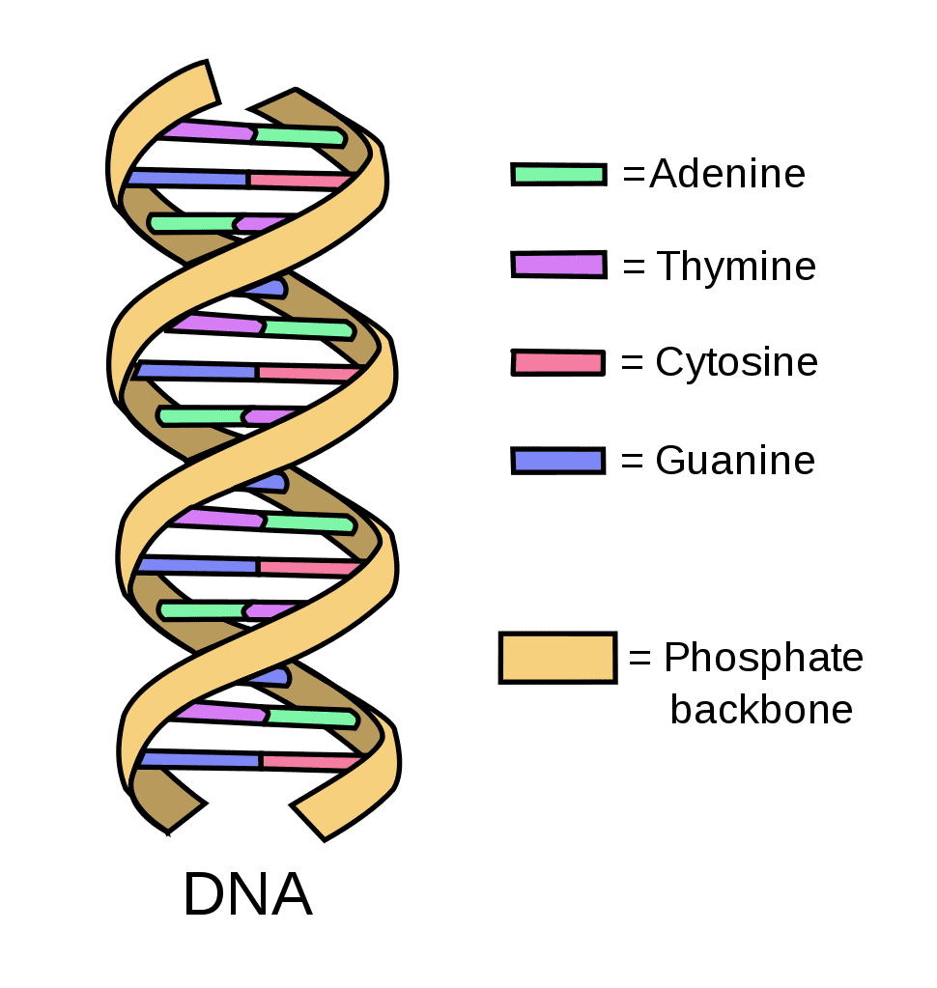
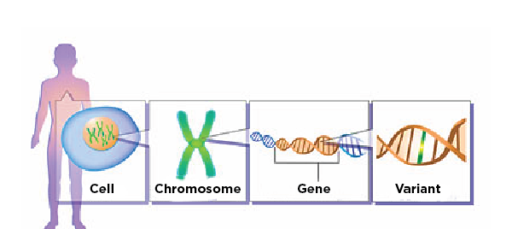
Basic Genetics
protein
mutant protein
https://www.epilepsy.com/learn/epilepsy-due-specific-causes/genetic-causes-epilepsy/genetics-basics

Slide 4
Open Targets Genetics Datasets
Dataset | Description | Approx Size (Format)
d2v2g | Intersection table linking studies to variants to genes | 700 Gb (JSON)
l2g | Locus to gene scores and subscores | 500 Mb (csv)
sa_gwas | Summary statistics for GWAS studies | 120 Gb (parquet)
sa_molecular_trait | Summary statistics for molecular trait studies | 35 Gb (parquet)
v2d | Data linking variants to studies | 10 Gb (JSON)
v2d_coloc | GWAS-GWAS and GWAS-molecular trait colocalisation results | 2 Gb (JSON)
v2d_credset | Fine mapped credible sets for all GWAS and molecular traits | 2 Gb (JSON)
v2g | Data linking variants to genes from V2G pipeline | 251 Gb (JSON)
variant-index | Variant index | 45 Gb (JSON)
genes-index | Gene index | 12 Mb (JSON)
study-index | Study metadata including trait, publication information | 10 Mb (JSON)
overlap-index | Pair-wise overlap between all independently associated GWAS loci | 1 Gb (JSON)
Total: ~ 1.2 T
ftp://ftp.ebi.ac.uk/pub/databases/opentargets/genetics

Slide 5
Project Goals and Challenges
Goals
Scalable data storage, preferable distributed in cloud object storage
Reasonable speed and good flexibility of query for complex fields
Rich APIs for downstream data analysis (especially python and R APIs)
Data analytic tools need to be able to handle big data
Challenges
Data size is pretty big and will continue to expand in batches
Some fields are complex data type

Slide 6
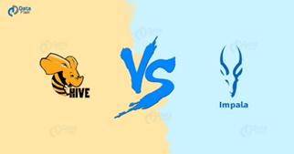

HDFS with Hive and Impala
My current solutions in production

Slide 7
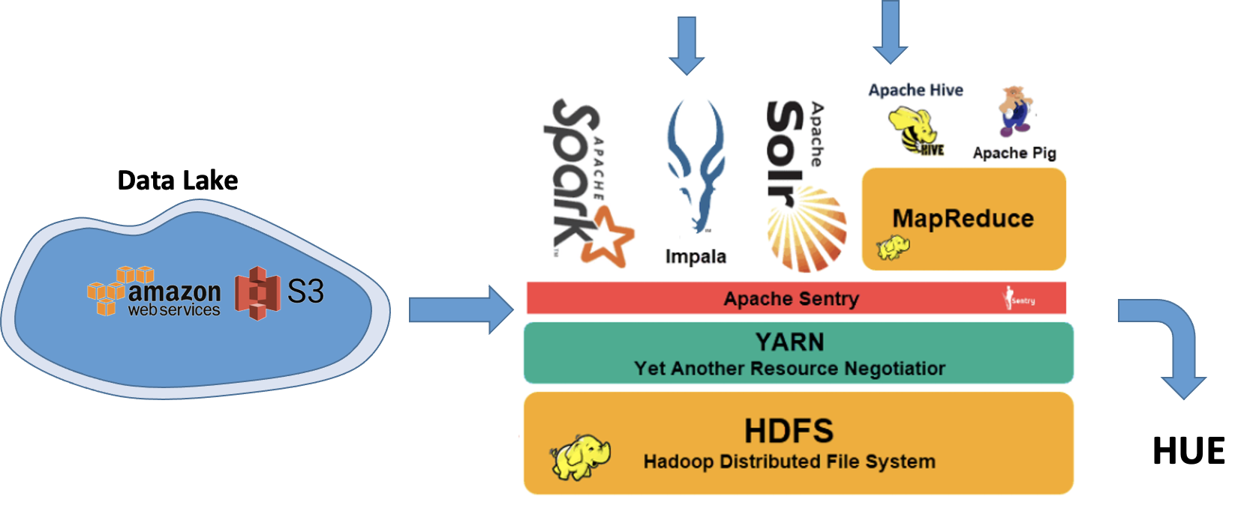
Data Architecture and Infrastructure
Cloudera Tech Stack
HUE

Slide 8
Hive/Impala vs RDB
RDB (schema on write)
Hive/impala (schema on read)
Design schema before-hand
Normalized data for speed
Store the data in a format optimized for consumer groups
Time consuming on building schema
High maintenance
Model your data when processing
Process data in raw format in a distributed file system (Hadoop map-reduce jobs under the cover)
Leverage the unlimited compute to transform data in transit
Support more complex data type
Notes:
Fundamental decision you make on how you organize the data in the big data environment

Slide 9

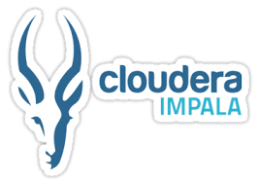
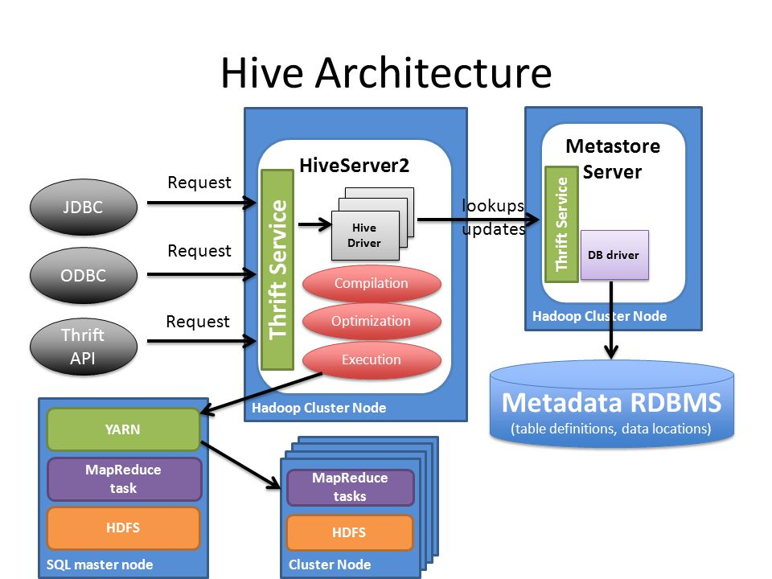
Query Big Data in the cloud using Hive and Impala
SQL query with schema on read
Two popular SQL engines in Hadoop ecosystem
They provide SQL-like interface to do interactive big data query on a distributed data, like HDFS and S3.
Hive/Impala Server
Metastore Server
query
HDFS

Slide 10
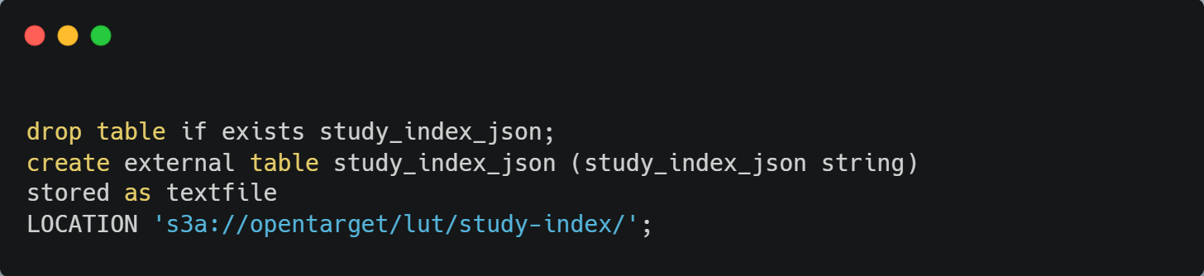
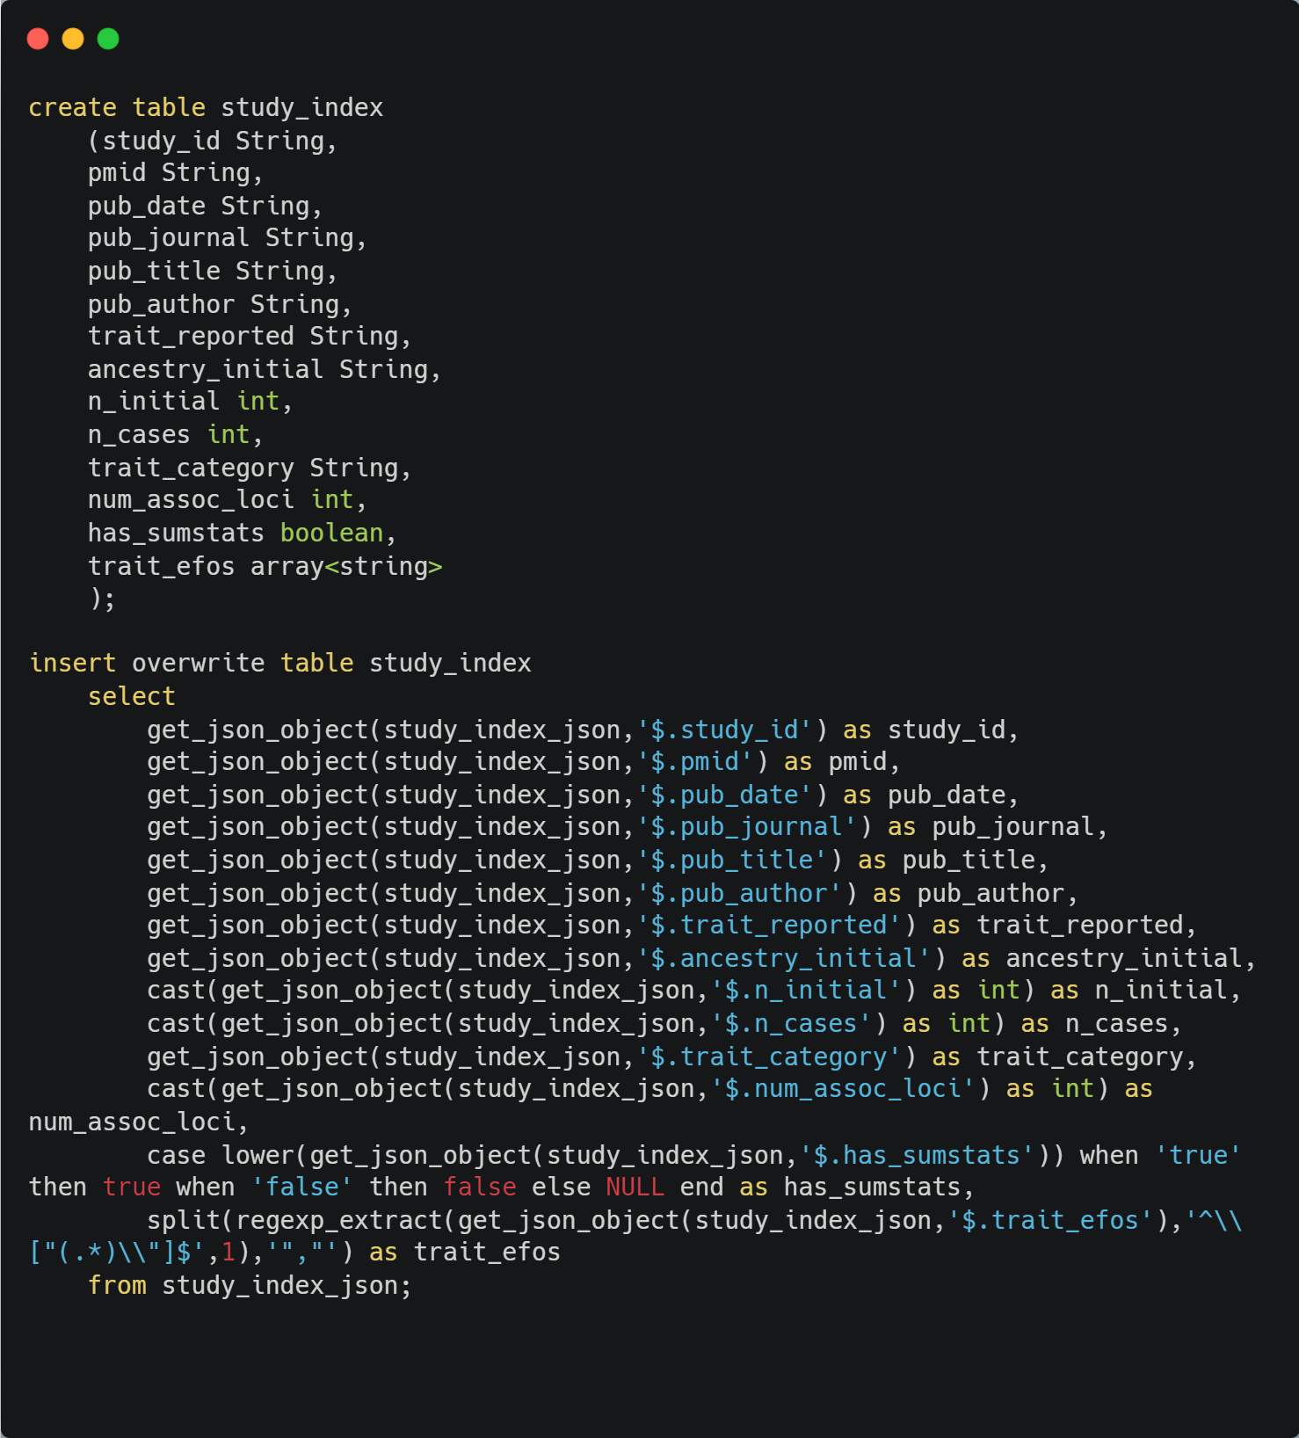
Data ETL process(study table as example)
Schema for staging table
Schema for data table
raw_json_data
aws s3
staging table
data table

Slide 11
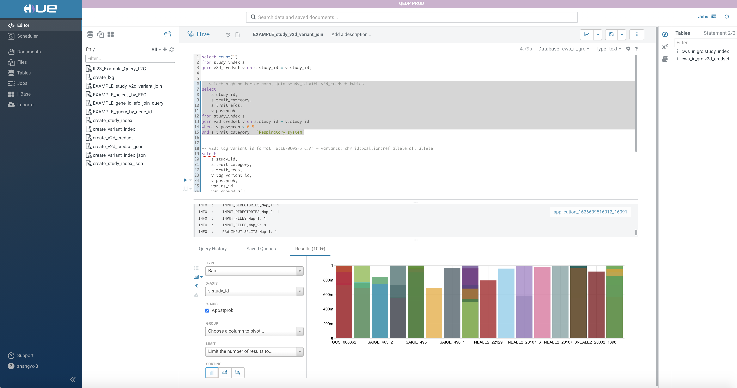
Data query and visualization using HUE
Hive and Impala SQL script
Query Results and Visualization

Slide 12
Advantages and Disadvantages
Advantages
Scalable storage. Data can be stored in the cloud
User-friendly Interface, HUE(Hadoop User Experience)
The syntax of HiveSQL is very similar to SQL, although the mechanisms under the hood are very different
Query time is reasonable fast for batch analysis
Disadvantages
Very limited APIs to use for downstream analysis
Data analytic functions and visualizations are very limited
Motivations to explore more database solutions

Slide 13
Explore and Compare Other Database Solutions

Slide 14
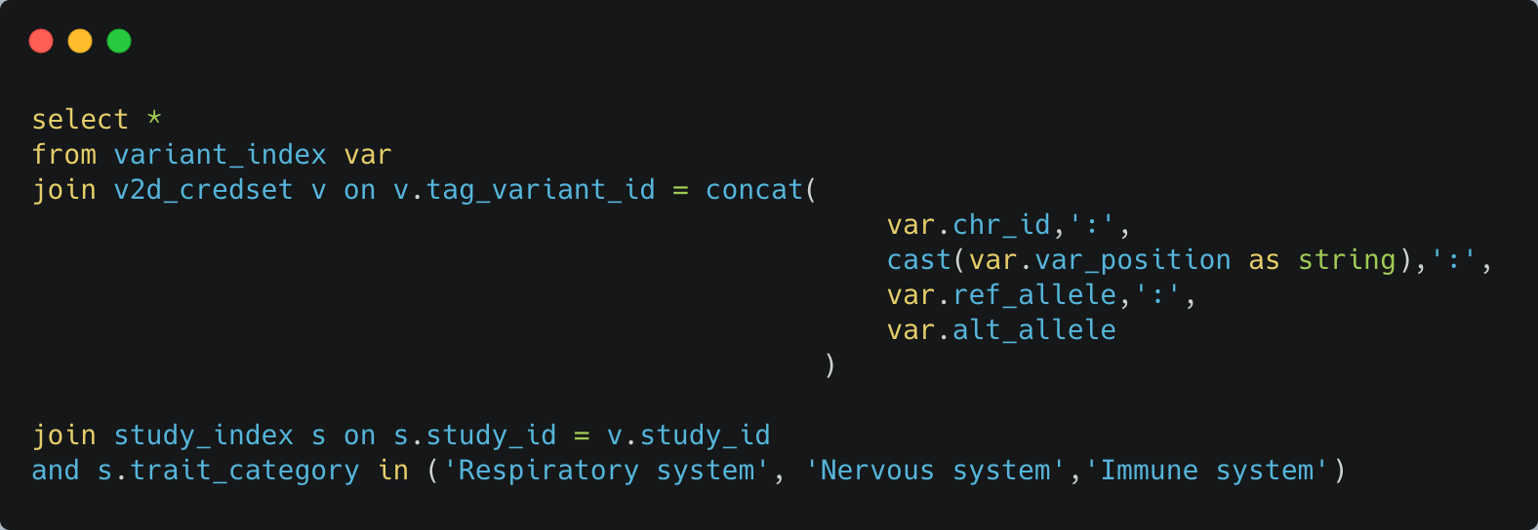
Subset the data in HDFS using Hive
Study_index: 19267 records
Variant_index: 72878709 records
V2d_credset: 31694678 records
Study_index_sample: 202 records
Variant_index_sample: 43626 records
V2d_credset_sample: 68362 records

Slide 15
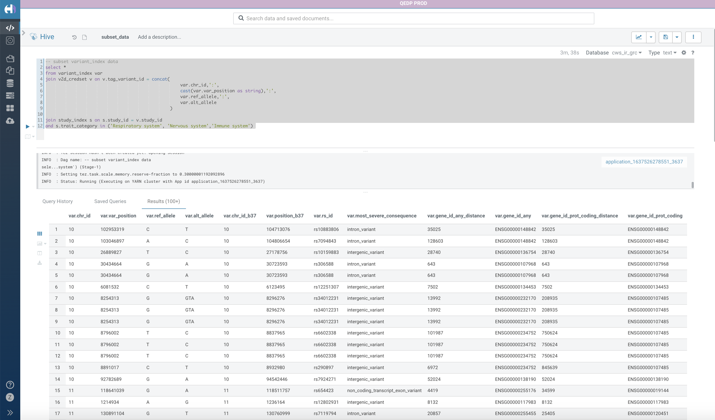
Subset the data in HDFS using Hive

Slide 16
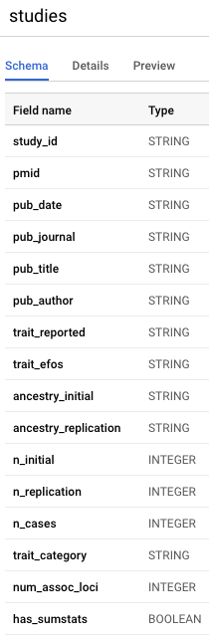
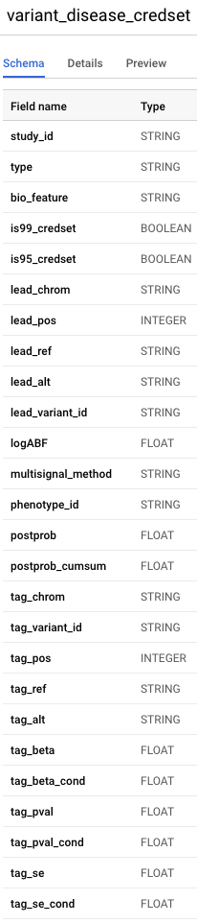
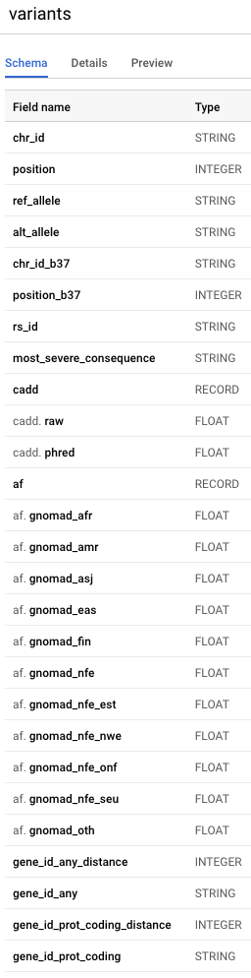
Objective:
Find coding variants with high posterior probability for a certain trait category of interest
Credible set files (JSON):
ftp://ftp.ebi.ac.uk/pub/databases/opentargets/genetics/20022712/v2d_credset/
Variant record files (JSON):
ftp://ftp.ebi.ac.uk/pub/databases/opentargets/genetics/20022712/lut/variant-index/
Study record files (JSON):
ftp://ftp.ebi.ac.uk/pub/databases/opentargets/genetics/20022712/lut/study-index/

Slide 17
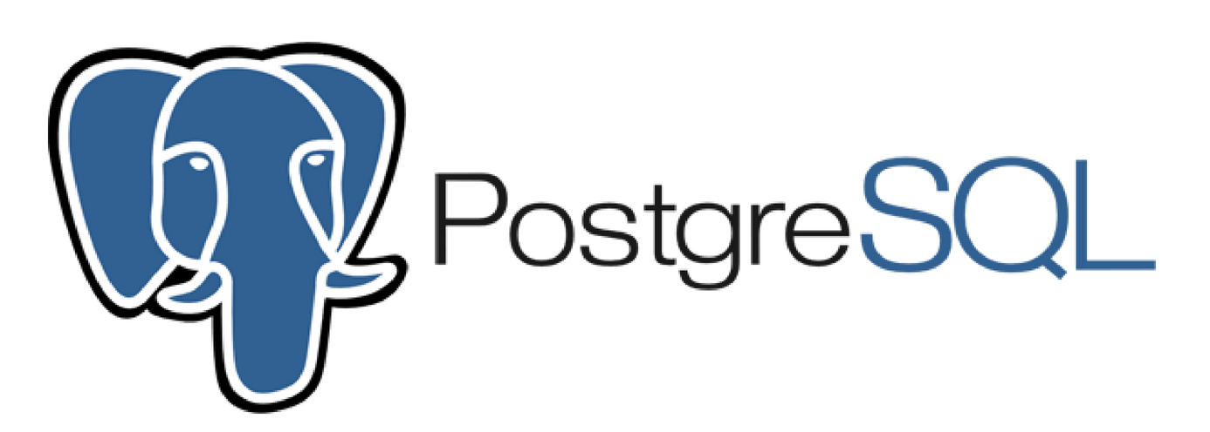
Modeling Open Target Data using PostgreSQL

Slide 18
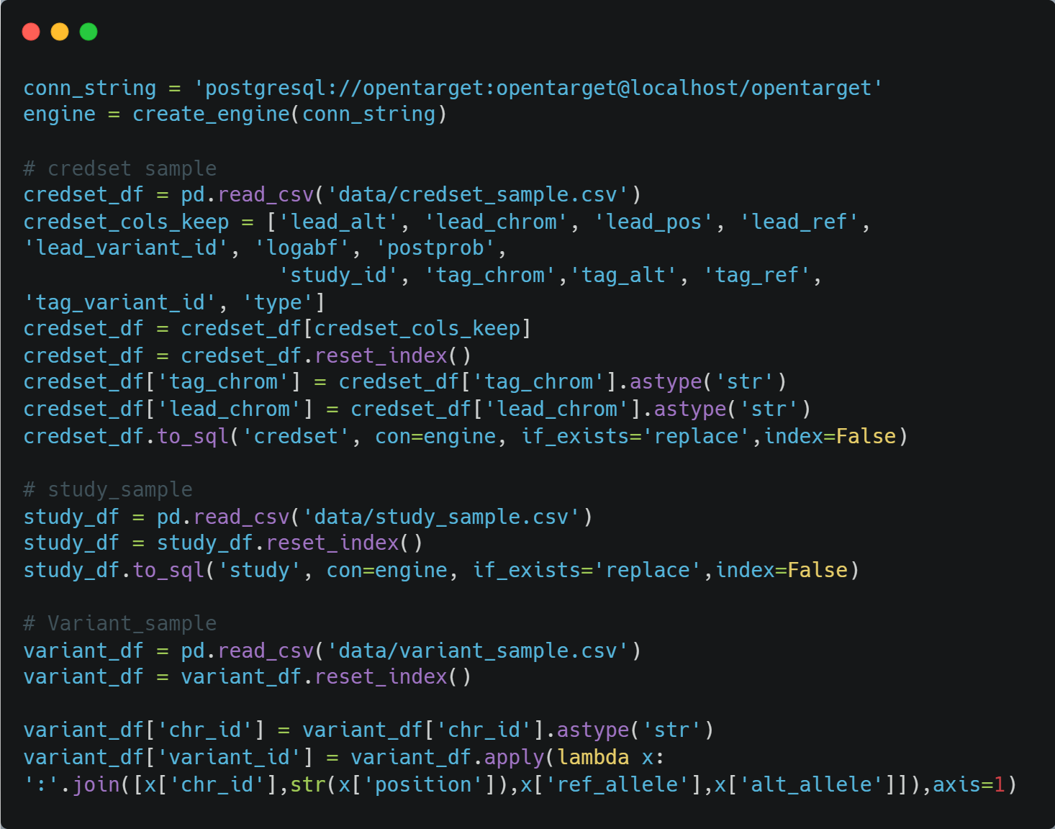
Data ETL process

Slide 19
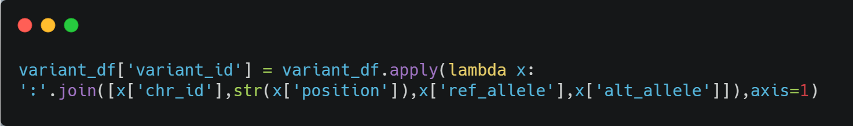
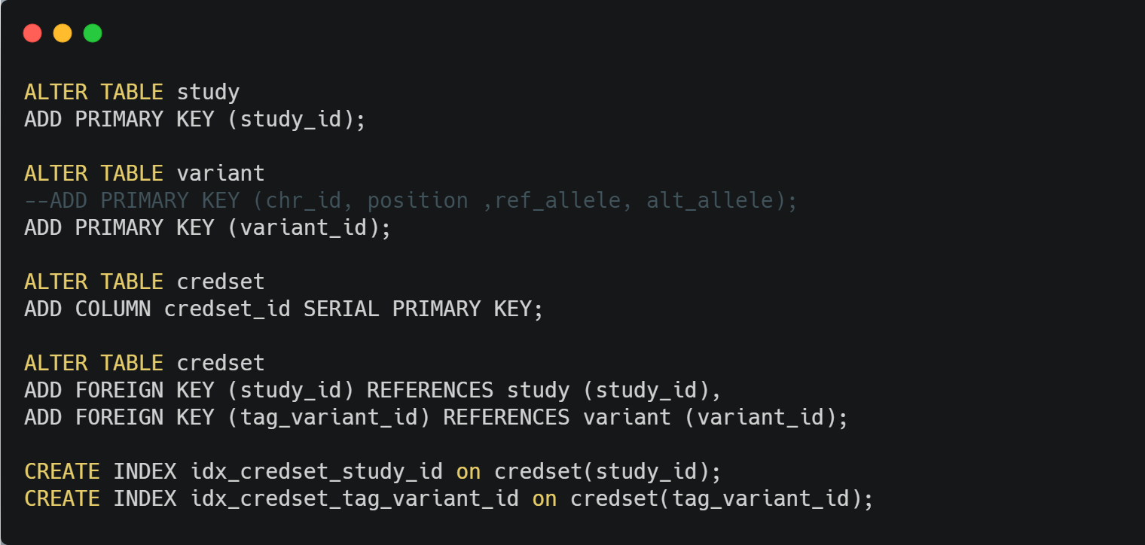
Build relations and index
Synthetic key
Primary & Foreign
keys and Index

Slide 20
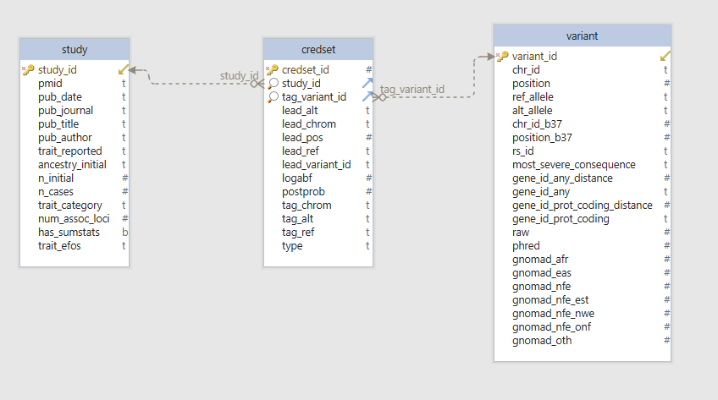
Postgres Schema

Slide 21
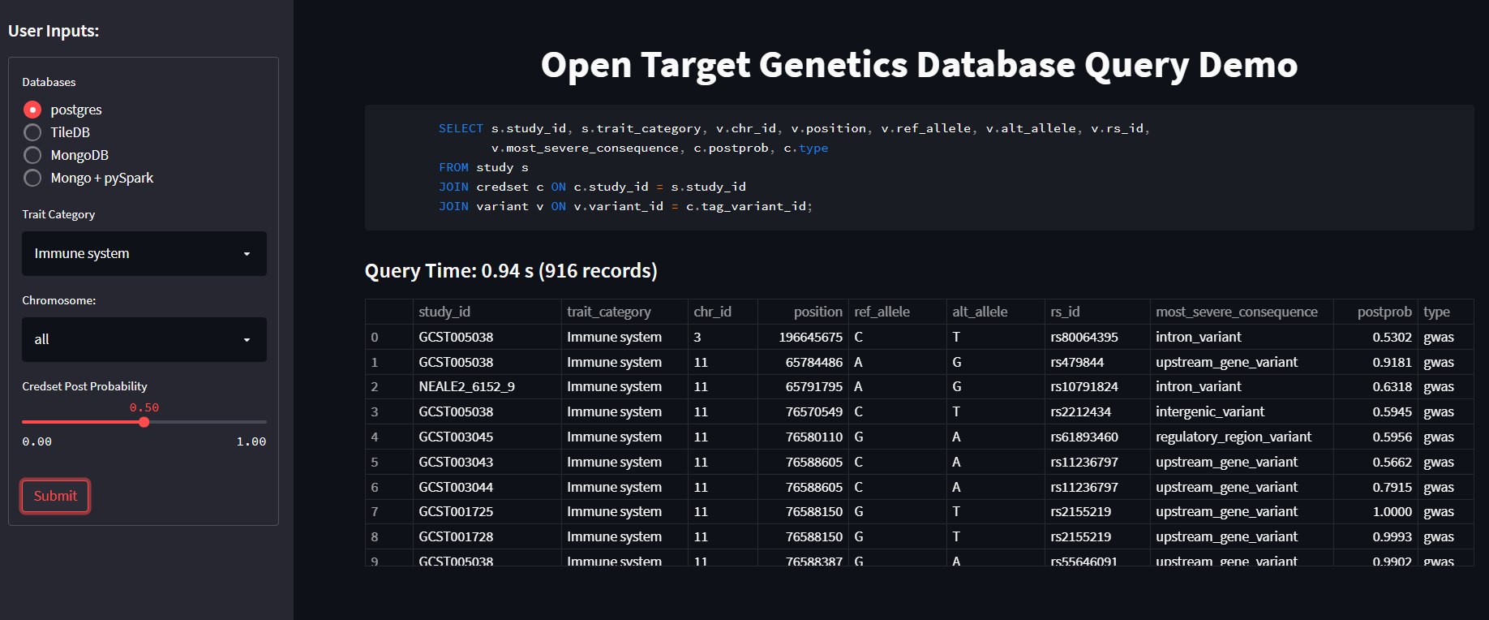
Query Demo - Postgres: - Find coding variants with high posterior probability for a certain trait category of interest

Slide 22

Modeling Open Target Data using TileDB

Slide 23
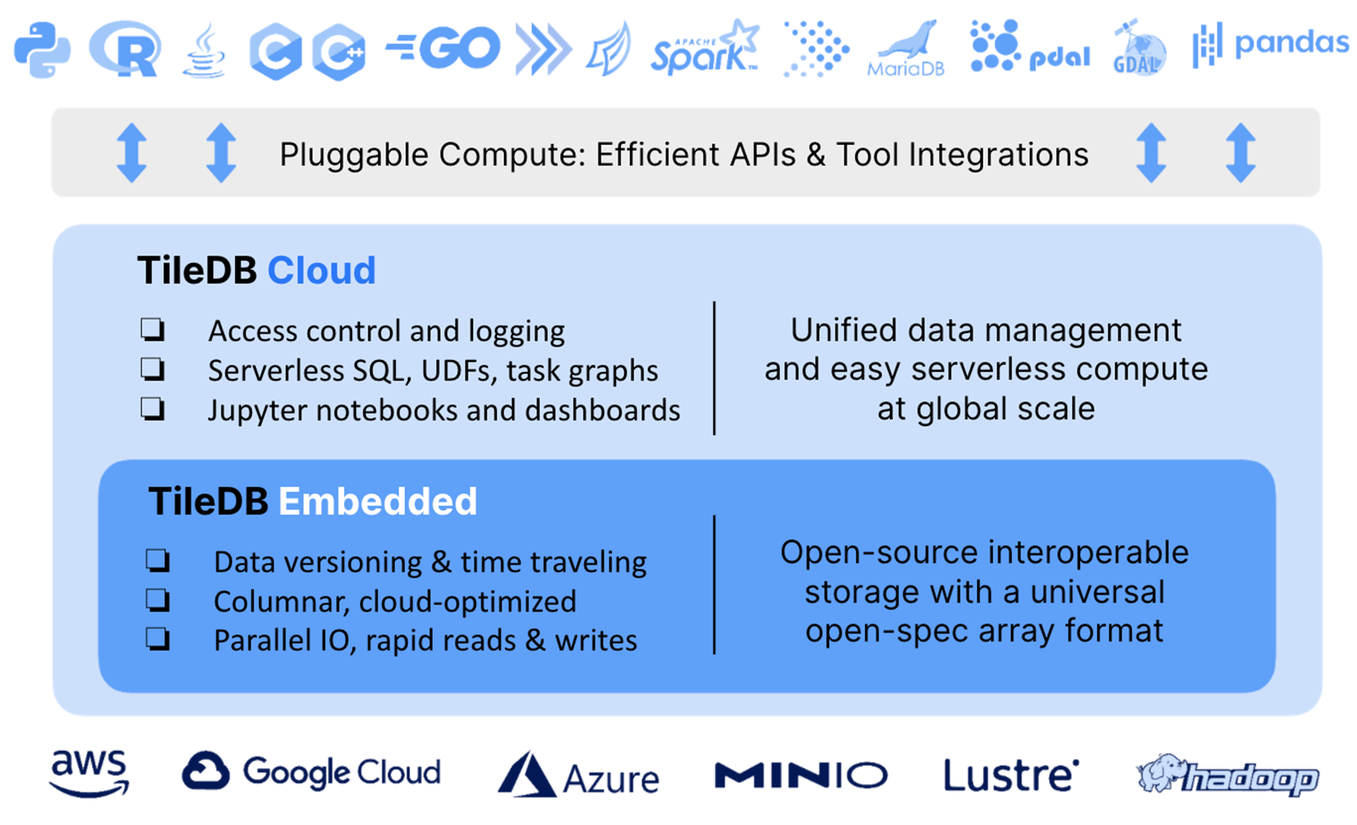
What is TileDB
TileDB is a universal data storage engine architected around multi-dimensional arrays that enables storing and accessing data using Dense or Sparse arrays data models.
Key Features
Native cloud object storage and access
Read/write queries are fully parallelized
Multi-dimensional indexing
Query times grow with result not data size
Time traveling
https://docs.tiledb.com/cloud/

Slide 24
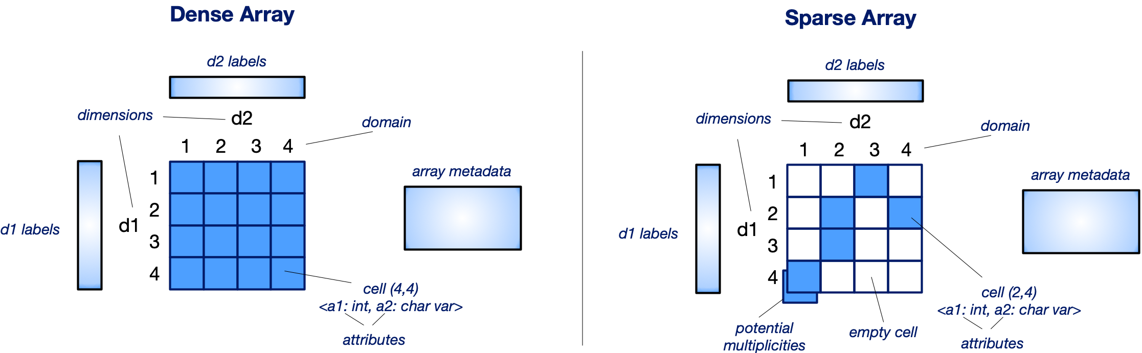
TileDB Data Model
https://docs.tiledb.com/main/concepts/data-model

Slide 25
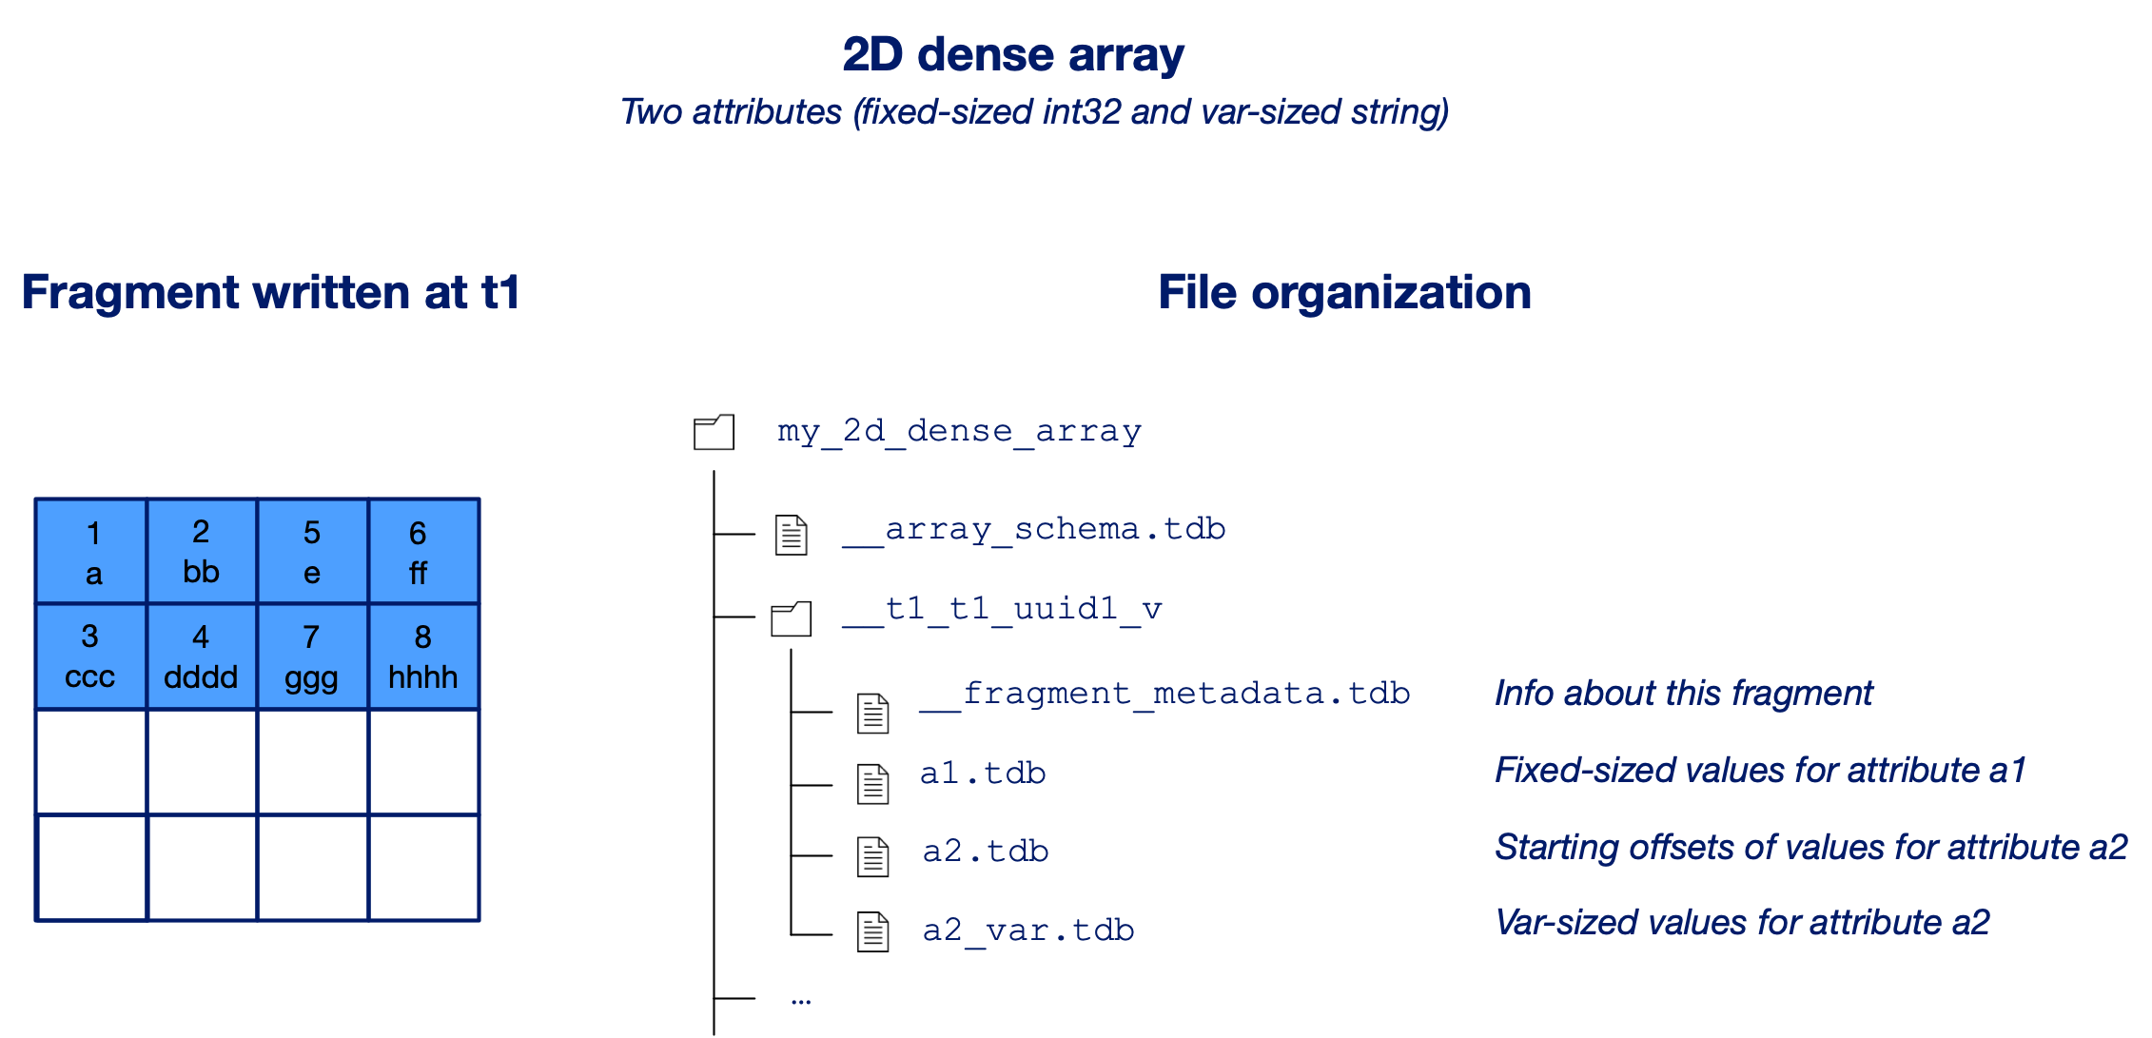
TileDB Data Format
TileDB employs the hierarchy multi-file data format (or object prefix hierarchies on cloud object stores). Necessary for supporting fast concurrent writes, especially on cloud object stores.
https://docs.tiledb.com/main/concepts/data-format

Slide 26
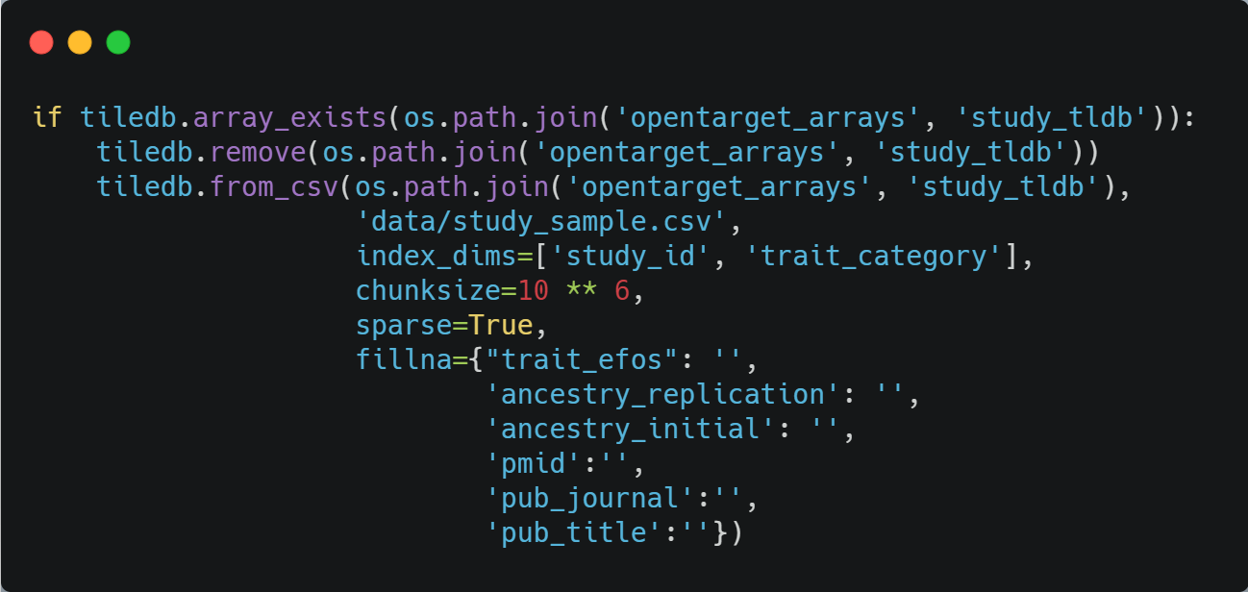
Build Study TileDB: Array Layout
study
Build study TileDB Array using python API
Dimention 1: study_id
pub_journal
Pub_title
Put_author
pub_date
…
Dimention 2: trait_category
What it looks like to what we learned?
Clustered index view
Multi-dimensional parquet

Slide 27
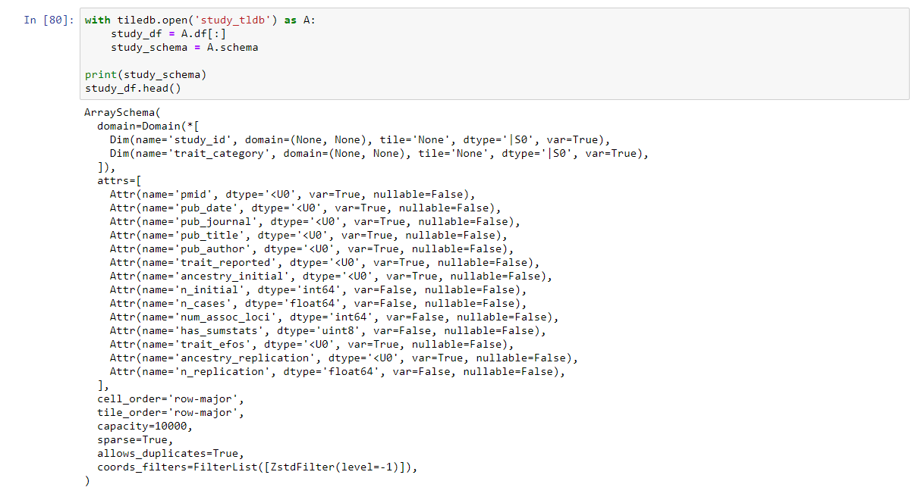
Read Study TileDB - the schema

Slide 28
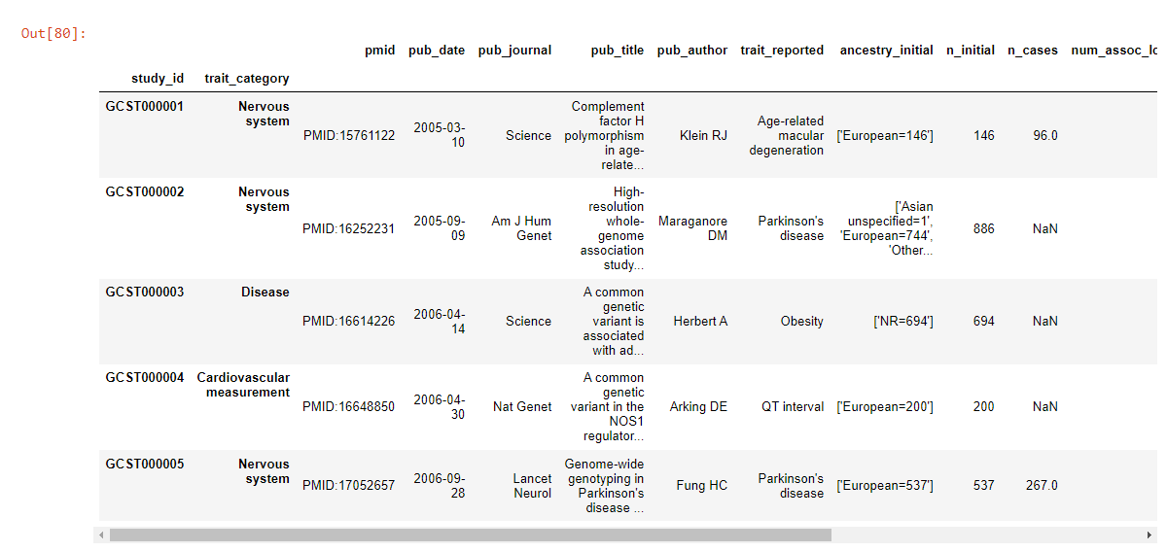
Read Study TileDB – the data

Slide 29
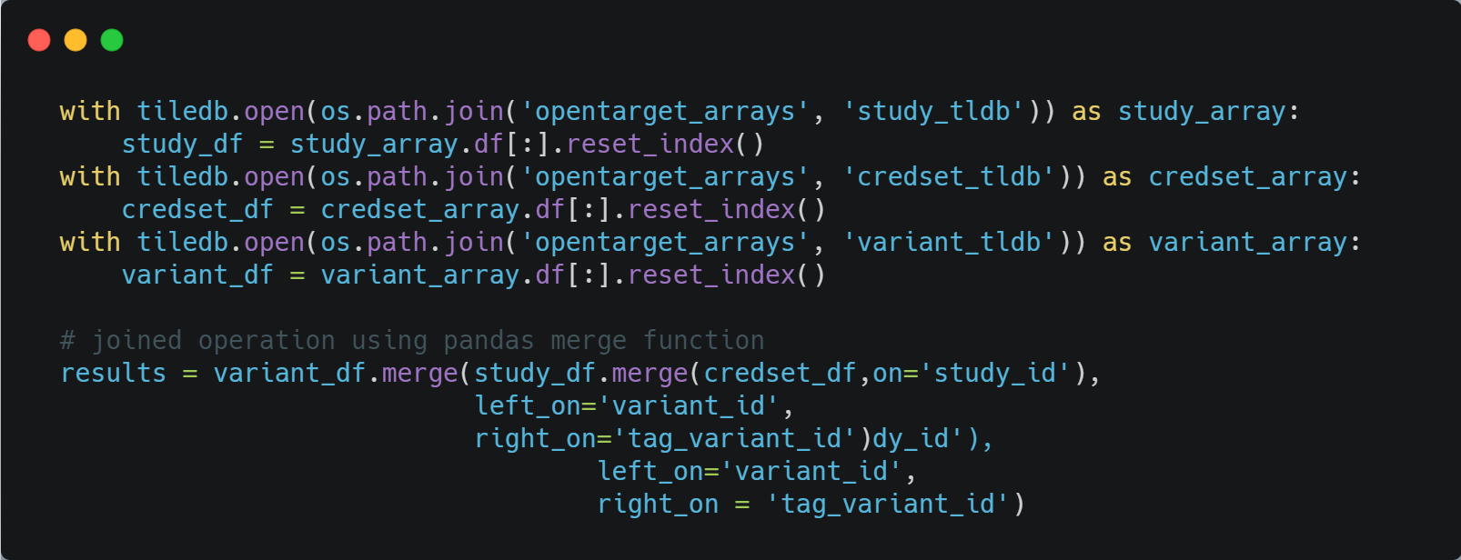
Joined query using pandas merge
NOTE: there are multiple ways of doing merging
EmBedded SQL: python API or MariaDB REPL (compatibility issues)
Pandas
pySpark

Slide 30

Modeling Open Target Data using MongoDB

Slide 31
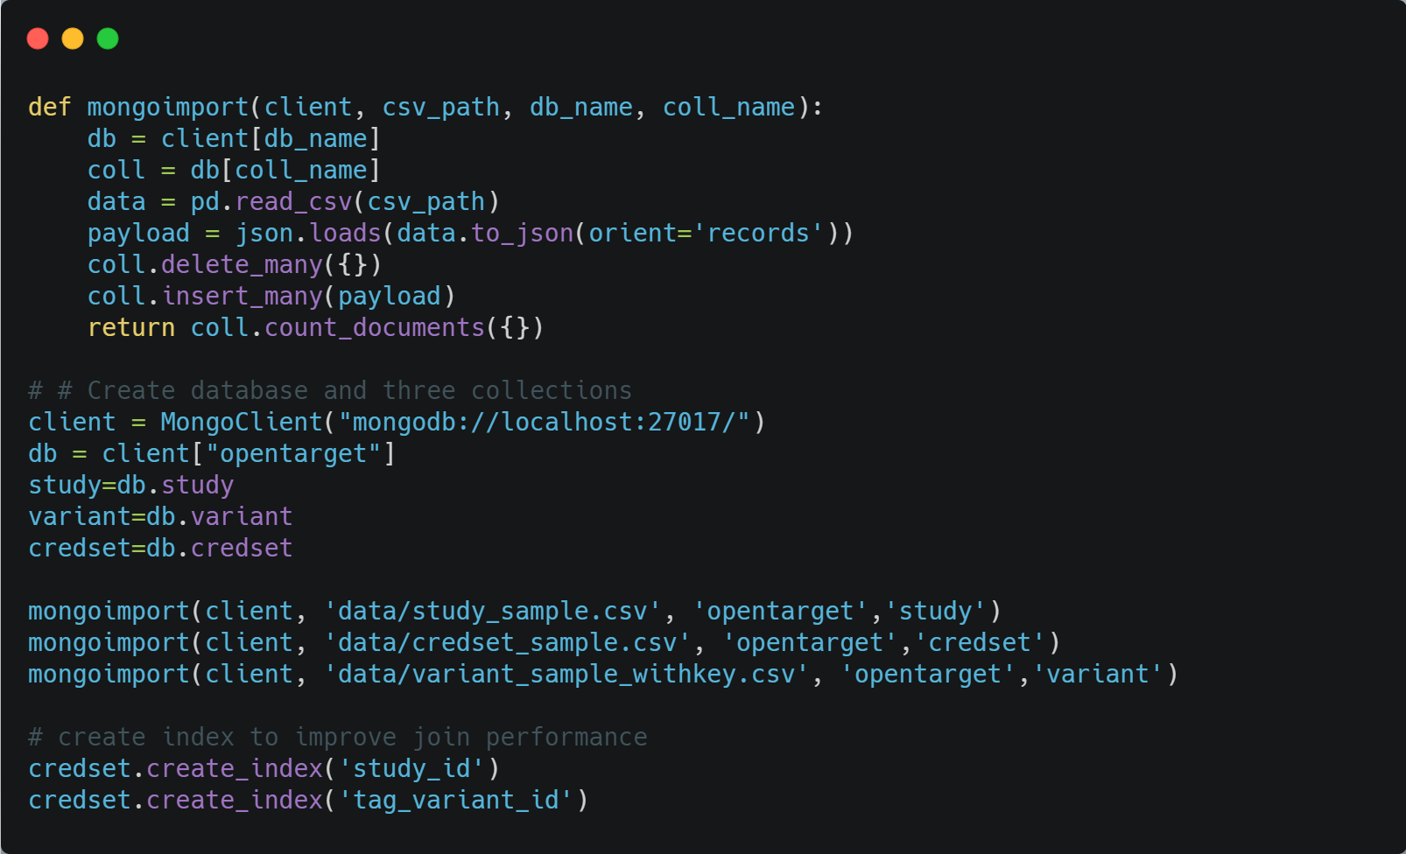
Inject data into database

Slide 32
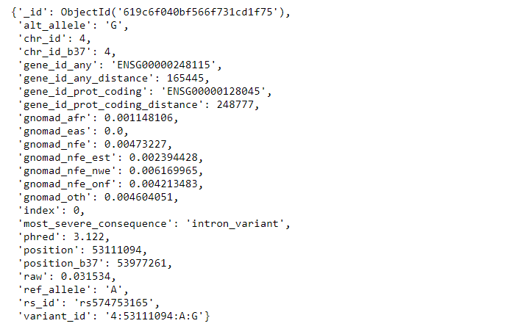
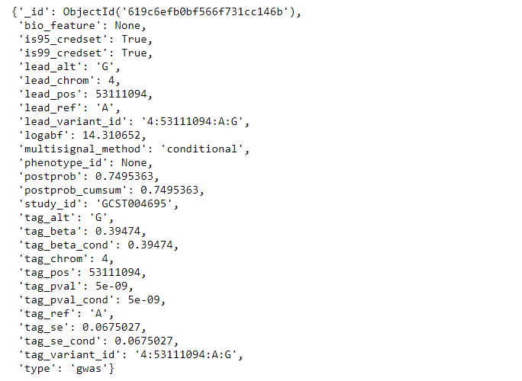
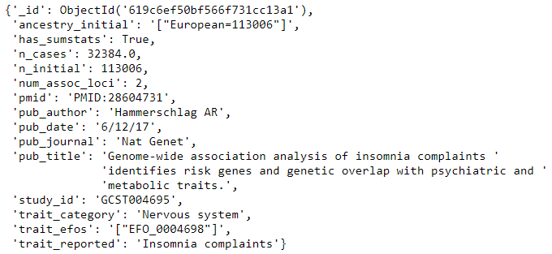
Collections
variant
credset
study

Slide 33
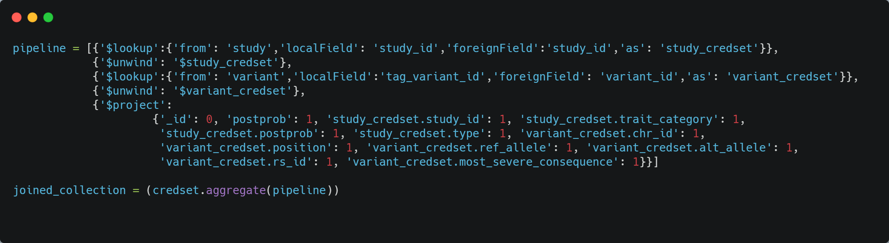
Joined query

Slide 34
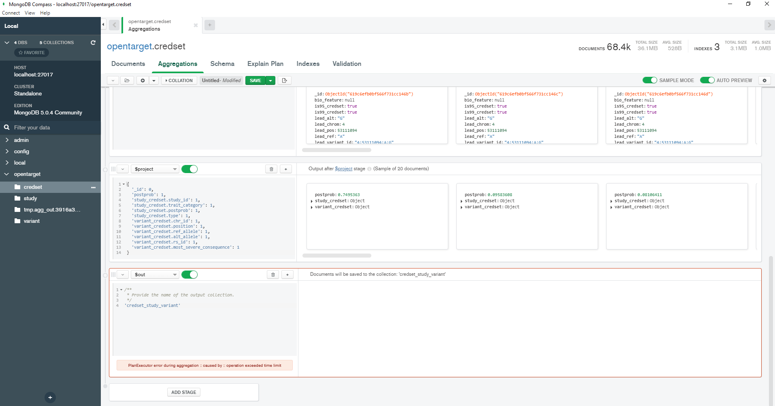
Joined query timeout
operation exceeded time limit!

Slide 35
Modeling Open Target Data using Spark and MongoDB

Slide 36
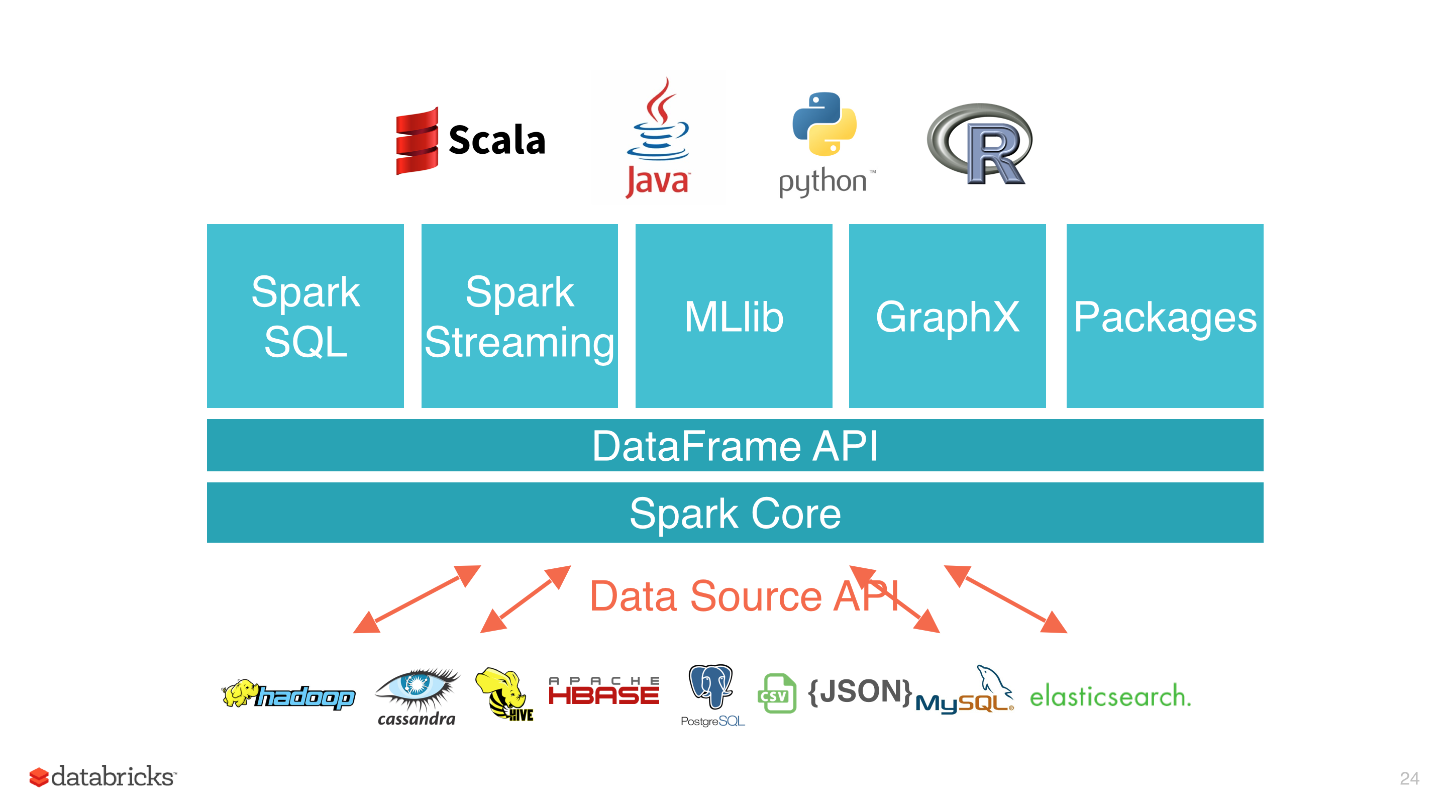
What is Spark
https://ogirardot.wordpress.com/2015/05/29/rdds-are-the-new-bytecode-of-apache-spark/

Slide 37
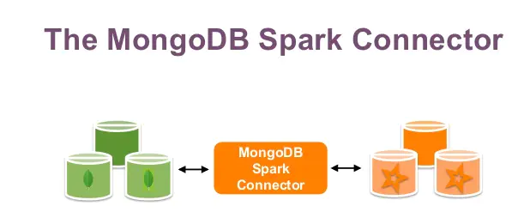
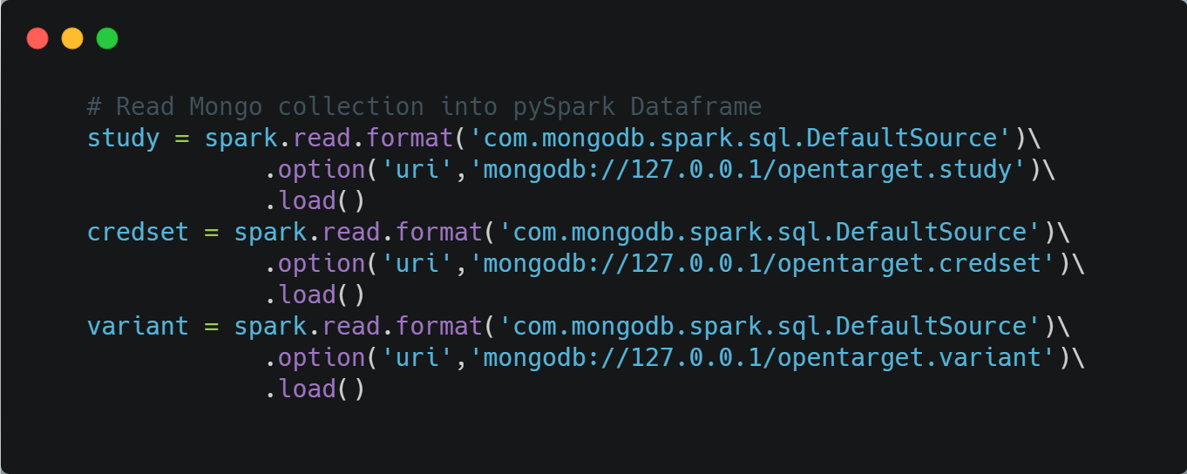
Read Data from MongoDB into Spark DataFrame

Slide 38
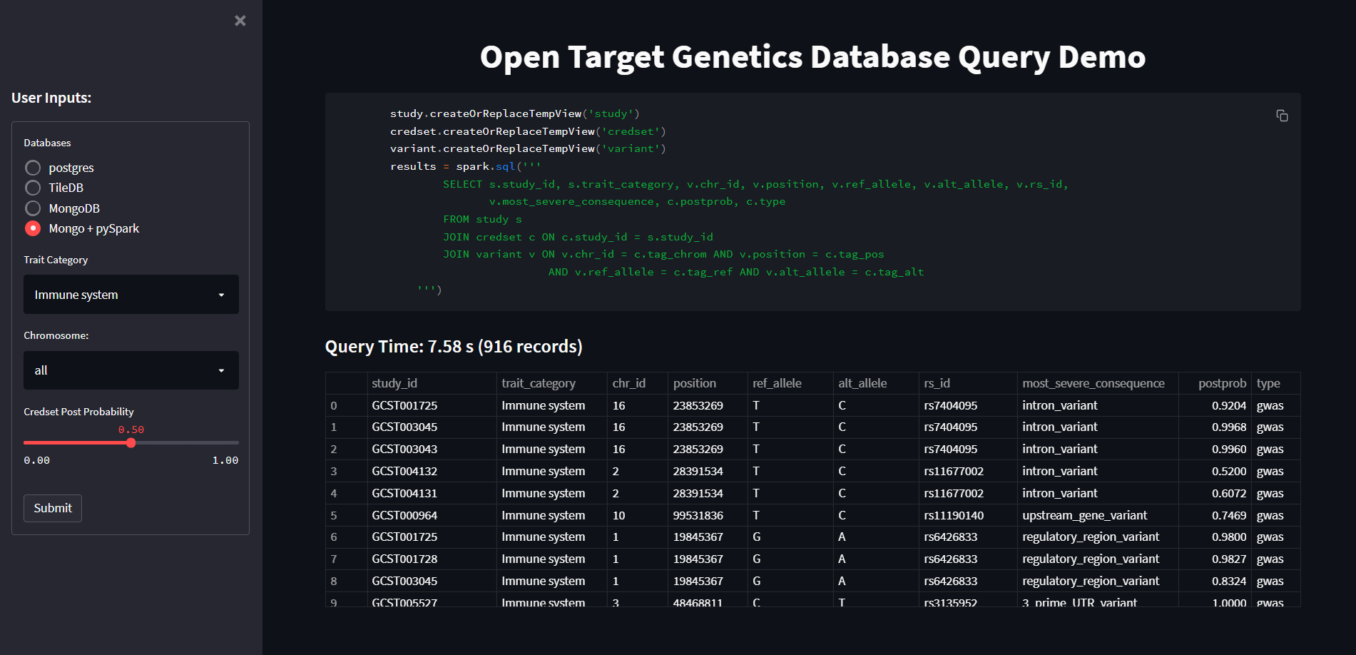
Perform joined query using spark SQL

Slide 39
Summary
HDFS and Hive/Impala
Raw data can be stored in S3, infinite space
Schema on read providing most flexibility, but lack of APIs and analytic functions
PostgreSQL
Take time for data preprocessing and design schema
Data query speed is the fastest among all options tested
TileDB
Good concept on big data storage and slicing; native distributed data storage in cloud
Yong history, still pretty buggy, data type support and compatibility issues with Python and Spark
Data slicing and feature filtering are optimized within the array
However, joined operation between arrays seem to be dependent on other framework, like Pandas/MariaDB/Spark
MongoDB
Inject JSON and CSV data into database is very easy, but really a pain to join between collections
Join speed is very slow! So MongoDB alone will not be sufficient for this project
MongoDB + pySpark
Distributed data storage and big data analytics with enrich APIs
SparkSQL can complement the aggregation and analyze function of MongoDB

Slide 40
Discussion
Big data analytics face challenges at every stage of the pipeline, from data storage, data ETL, data analytics and visualization. There are also many tools at each stage for data engineers and analysts to choose. The database solutions discussed in this project are exploratory and preliminary, and may be serve as non-exclusive examples for database implementation
The official Open Target has its implementation, which provide service to public using web api. It is still pretty new, but an innovative and evolving big data platform for severing life science community. Their data architecture has the multiple components including databases and big data tools that deserve a whole dedicated team to work on it
Job description and requirements for Technical Project Lead (Open Targets) (https://www.embl.org/jobs/position/EBI01936 )
Scala and Spark for ETL pipeline
Data is injected into ElasticSearch and ClickHouse
Data is served in the front end using GraphQL APIs using Play framework and consumed by React-based web interface
All applications are deployed and served in Google Cloud Platform using Terraform
Besides all above, all resulting datasets are made available to public through different channels using Google BigQuery

Slide 41
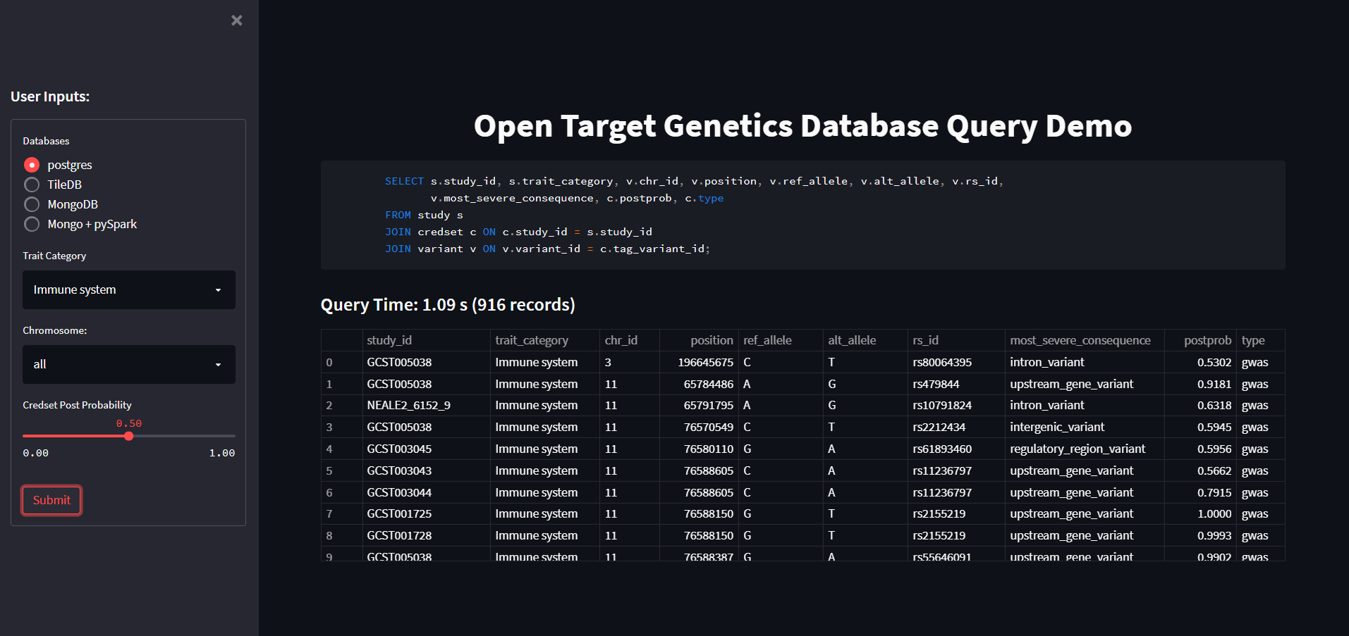
Web application DEMO
http://localhost:8501/

